Slide 1



Title: Predictive Model for Carbon Emission Detector using Machine Learning and Stream lit Interface
Names: Dhruv Gupta, Sarthak, Manas Verma
Roll Numbers: 2022a6r016 2022a6r044 2022a6r052
Branch: CSE AI-ML
Model Institute of Engineering & Technology

Slide 2
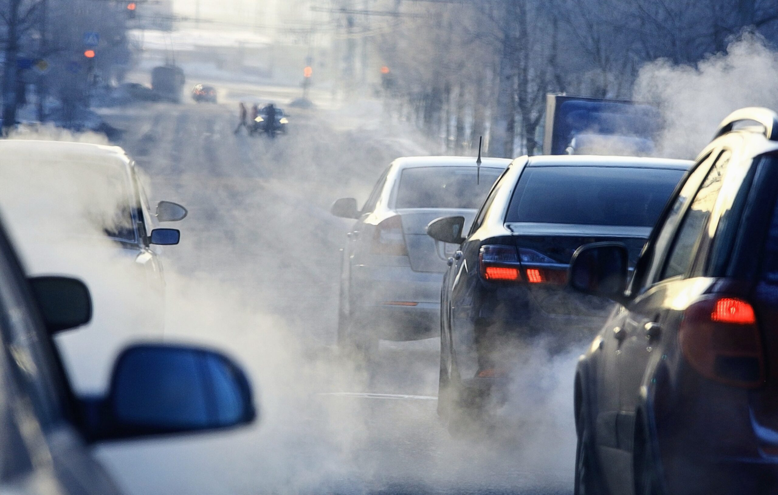
Problem Statement
Every time we start the engine, CO₂ goes up into the atmosphere. And with more vehicles hitting the road every year, it’s becoming a serious issue.
The challenge?
We don’t have smart tools that can predict emissions for any vehicle in real time. Most of the existing methods are outdated, manual, or just too generic to be useful.

Slide 3
Project Objectives & Approach
Our Objectives:
Predict CO₂ emissions based on vehicle specifications.
Compare the effectiveness of three ML models:
Linear Regression
Random Forest
XGBoost
Deploy a user-friendly web app using Streamlit.
Approach:
Data preprocessing, model training, and evaluation using standard regression metrics.
Interactive dashboard for real-time prediction and analysis.

Slide 4
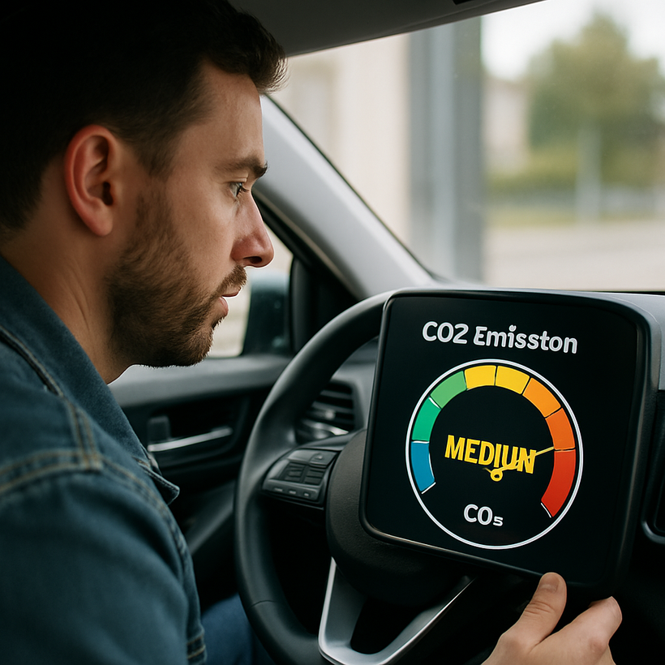
Solution
We built a machine learning model that predicts a vehicle’s CO₂ emissions (g/km) based on its specifications — like engine size, fuel type, cylinders, and fuel consumption. And showcases it in a user friendly format using Streamlit web interfaces.
Our goal is to make CO₂ impact estimation easy, accessible, and actionable — for everyone from car makers to policymakers.

Slide 5
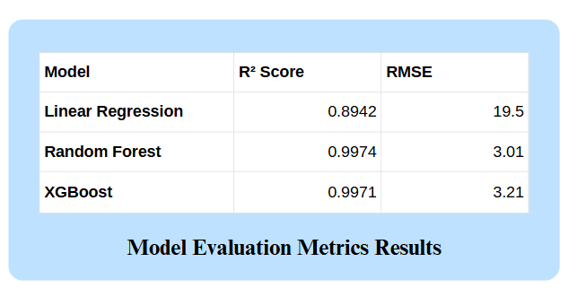
Model Evaluation and Results
Features Used:
1. Engine Size (L)
2. Cylinders
3. Fuel Type
4. Fuel Consumption
Target Variable:
CO₂ Emissions (g/km)

Slide 6
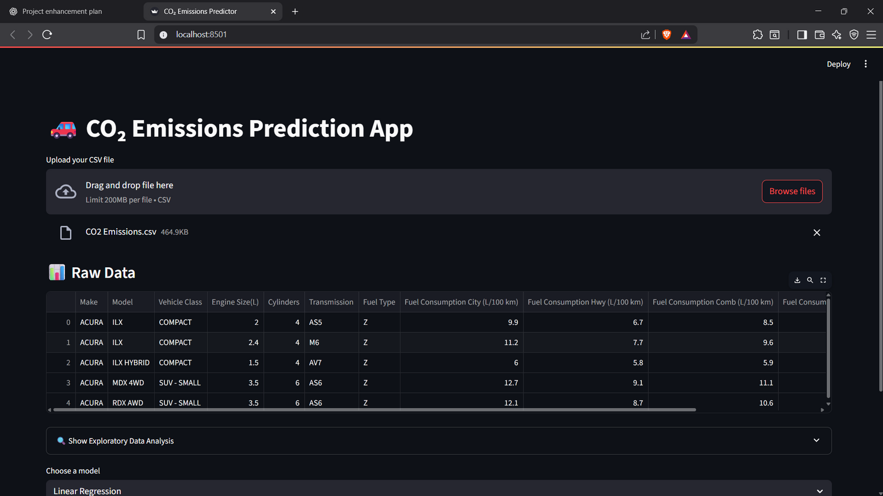
Streamlit Web App & Real-World Impact
App Features:
Upload vehicle datasets.
Choose a prediction model.
Get real-time emission predictions.
Visualize results and trends.
Potential Applications:
Government: Regulatory planning
Industry: Eco-friendly vehicle design
Consumers: Understand vehicle environmental impact

Slide 7

Applications
Automotive Industry
Design and evaluate low-emission vehicles
Policy Making
Support development of environmental regulations
Research and Academia
Analyze emission trends and vehicle impact
Consumers
Compare environmental footprint before purchasing

Slide 8


